Slide 1
Physics Questions and Answers
SUSSEX PRIMARY MCQ TEACHING
Ben Hardy
PLEASE DO NOT COPY OR DISTRIBUTE SLIDES

Slide 2
Learning objectives:
With reference to RCOA curriculum competence e.g.
To demonstrate knowledge of:
PC_BK_07 SI Units: fundamental units and derived units
PC_BK_08 Other non SI units relevant to anaesthesia: including mmHg, bar, atmospheres, cm H2O, psi
PC_BK_09 Simple mechanics: mass, force, work, energy, power PC_BK_10 Heat: including temperature, absolute zero
PC_BK_11 Heat transfer and loss: conduction, convection, radiation, evaporation
PC_BK_13 Latent heats, triple point of water
PC_BK_16 Laws of thermodynamics; mechanical equivalent of heat
PC_BK_17 Humidity, absolute and relative; including measurement
PC_BK_19 Physics of gases. Gas Laws: kinetic theory of gases, Boyles, Henry’s, Dalton, Charles, Gay-Lussac
PC_BK_20 Critical temperature, critical pressure
PC_BK_22 Pressure: absolute and relative pressure; gauge pressure

Slide 3
Learning objectives:
With reference to RCOA curriculum competence e.g.
To demonstrate knowledge of:
PC_BK_23 Manufacture and storage of gases and vapours, safety
PC_BK_24 Cylinders and pipelines, Bourdon gauge
PC_BK_26 Scavenging devices
PC_BK_29 Laminar and turbulent flow: Hagen-Poiseuille equation, Reynold’s number, examples including helium
PC_BK_30 Measurement of volume and flow in gases and liquids, including pneumotachograph and other respirometers
SM_BK_04 Recalls the types of data and their representation SM_BK_05 Explains the normal distribution as an example of parametric distribution
SM_BK_06 Explains indices of central tendency and variability
SM_BK_07 Recalls simple probability theory and the relationship to confidence values
SM_BK_09 Explains the choices for simple statistical tests for different types of data

Slide 4
SBAs
Notes:
Question slide without timer

Slide 5
SUSSEX PRIMARY MCQ TEACHING
1. Regarding laminar flow of liquids in tubing, which increases the flow rate the most?
Doubling the radius of the tube
Doubling the pressure gradient
Doubling the length of the tubing
Halving the viscosity
Halving the radius of the tube

Slide 6
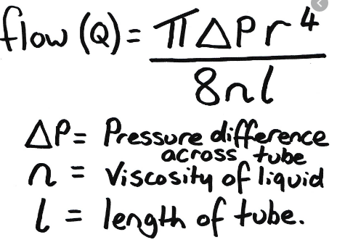
Regarding laminar flow of liquids in tubing, which increases the flow rate the most?
Doubling the radius as this will increase flow 16 fold
Doubling the radius of the tube
Doubling the pressure gradient
Doubling the length of the tubing
Halving the viscosity
Halving the radius of the tube
Notes:
Answer slide

Slide 7
SUSSEX PRIMARY MCQ TEACHING
2. A closed fixed box containing 100ml of air at sea level is then injected with 50ml of desflurane, what is the pressure inside the box?
150kPa
202kPa
239kPa
291kPa
378kPa

Slide 8
A closed fixed box containing 100ml of air at sea level is then injected with 50ml of desflurane, what is the pressure inside the box?
Pressure of box 101kpa (atmospheric)
Add desflurane, 100ml of air into 50mls => 202kPa
SVP desflurane = 89kPa
202 + 89 = 291kPa
150kPa
202kPa
239kPa
291kPa
378kPa
Notes:
Answer slide

Slide 9
SUSSEX PRIMARY MCQ TEACHING
3. The data obtained from a study is non-parametric and negatively skewed. Which is the most accurate statement?
The mean, median and mode are all the same
The value of the mean is higher than the median which is higher than the mode
The value of the median is higher than the mean which is higher than the mode
The value of the mode is higher than the median which is higher than the mean
The value of the mode is higher than the mean which is higher than the median

Slide 10
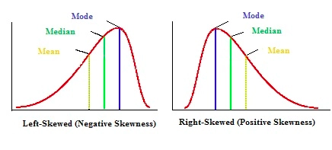
The data obtained from a study is non-parametric and negatively skewed. Which is the most accurate statement?
The mean, median and mode are all the same
The value of the mean is higher than the median which is higher than the mode
The value of the median is higher than the mean which is higher than the mode
The value of the mode is higher than the median which is higher than the mean
The value of the mode is higher than the mean which is higher than the median
Notes:
Answer slide

Slide 11
SUSSEX PRIMARY MCQ TEACHING
4. You have placed a patient on a circle system with a soda lime canister. The patient produces 2 moles of carbon dioxide, how many moles of calcium carbonate will be produced?
1
2
4
6
8

Slide 12
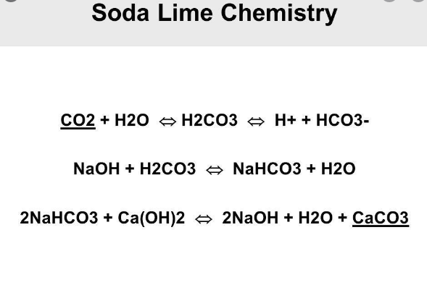
You have placed a patient on a circle system with a soda lime canister. The patient produces 2 moles of carbon dioxide, how many moles of calcium carbonate will be produced?
The overall reaction is:
CO₂ + Ca(OH)₂ → CaCO₃ + H₂O + heat (in the presence of water)
Broken Down:
1
2
4
6
8
Notes:
Answer slide

Slide 13
SUSSEX PRIMARY MCQ TEACHING
5. A 45kg child that is spontaneously breathing is placed on breathing circuit. Fresh gas flows of 4 litres are required to prevent rebreathing. Which breathing circuit is most likely to be used?
Mapleson C
Mapleson B
Mapleson F
Bain’s circuit
Magill circuit

Slide 14
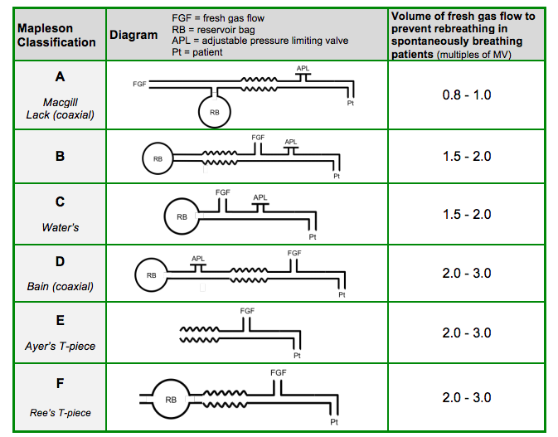
A 45kg child that is spontaneously breathing is placed on breathing circuit. Fresh gas flows of 4 litres are required to prevent rebreathing. Which breathing circuit is most likely to be used?
Mapleson C
Mapleson B
Mapleson F
Bain’s circuit
Magill circuit
Notes:
Answer slide

Slide 15
SUSSEX PRIMARY MCQ TEACHING
6. A 25 year old patient is undergoing I&D of an abscess, with maintenance of anaesthesia with sevoflurane . You notice their MAC is reading 0.5, and the dial is at 4%. Which of the following will increase the depth of anaesthesia the quickest?
Switch the sevoflurane to desflurane at 8%
Increase the sevoflurane dial to 8%
Decrease the sevoflurane dial to 2%
Increase the fresh gas flow
Add in nitrous oxide 50%

Slide 16
A 25 year old patient is undergoing I&D of an abscess, with maintenance of anaesthesia with sevoflurane . You notice their MAC is reading 0.5, and the dial is at 4%. Which of the following will increase the depth of anaesthesia the quickest?
Switch the sevoflurane to desflurane at 8%
Increase the sevoflurane dial to 8%
Decrease the sevoflurane dial to 2%
Increase the fresh gas flow
Add in nitrous oxide 50%
Notes:
Answer slide

Slide 17
SUSSEX PRIMARY MCQ TEACHING
7. A sealed jar contains multiple gases, which when their partial pressures are added together gives a total pressure inside the jar of 100kPa. Which gas law is being demonstrated?
Boyle’s law
Henry’s Law
Dalton’s Law
Gay-Lussac’s law
Universal gas constant

Slide 18
A sealed jar contains multiple gases, which when their partial pressures are added together gives a total pressure inside the jar of 100kPa. Which gas law is being demonstrated?
Daltons Law = additive effects of gases to make a total pressure
Henry's Law = at a given temperature, the amount of gas dissolved in a solute is directly proportional to the pressure of the gas above the substance.
Boyle’s law
Henry’s Law
Dalton’s Law
Gay-Lussac’s law
Universal gas constant
Notes:
Answer slide

Slide 19
SUSSEX PRIMARY MCQ TEACHING
8. A 4 year old child presents to ED in cardiac arrest. CPR is immediately commenced. The rhythms is VF and decision is made to defibrillate. What energy level would be most appropriate?
16 Joules
32 Joules
64 Joules
80 Joules
120 Joules

Slide 20
A 4 year old child presents to ED in cardiac arrest. CPR is immediately commenced. The rhythms is VF and decision is made to defibrillate. What energy level would be most appropriate?
Old formula = (age + 4 ) x 2
Newer formulae:
Weight 0 -1 = (Age/2)+4
Weight 1 -5 = (Age x2)+8
Weight 6 -12 = (Age x3)+7
(4 + 4 ) x 2 => 16 kg
( 4x2 ) + 8 => 16 kg
4 Joules per kg => 64 J
16 Joules
32 Joules
64 Joules
80 Joules
120 Joules
Notes:
Answer slide

Slide 21
SUSSEX PRIMARY MCQ TEACHING
9. Which derived quantity is best expressed in terms of the base SI units of Kg m⁻¹ s⁻²
Force
Energy
Pressure
Power
Speed

Slide 22
Which derived quantity is best expressed in terms of the base SI units of Kg m⁻¹ s⁻²
Speed = dist / time ms⁻¹
Acceleration => ms⁻²
Force = mass x acc kg x ms⁻²
Pressure = force / area kg m s⁻² / m²
kg m⁻¹ s⁻²
WD = force x distance kg m s⁻² x m
kg m² s⁻²
Power = WD / time kg m² s⁻² / s
kg m² s⁻³
Force
Energy
Pressure
Power
Speed
Notes:
Answer slide

Slide 23
SUSSEX PRIMARY MCQ TEACHING
10. Which one of the following statements is most specific for the Bain circuit compared to other breathing systems?
It has an adjustable pressure limiting valve at the common gas outlet
It is more efficient for controlled compared with spontaneous ventilation
It is a co-axial circuit
It is a semi-open circuit
It is used a paediatric breathing circuit

Slide 24
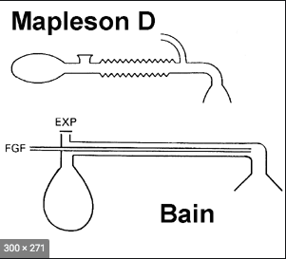
Which one of the following statements is most specific for the Bain circuit compared to other breathing systems?
The Bain circuit is a semi-open breathing system.
It is a coaxial version of a Mapleson D circuit. Other examples of coaxial breathing systems include the Lack (Mapleson A) and circle.
Bain and Lack circuits have an APL valve at the common gas outlet
The Bain circuit can be used at any age and weight.
Use an appropriately sized revervoir bag as an alternative to a Mapleson E or F circuit.
The FGF for spont. breathing (to avoid rebreathing) is 160-200 ml/kg/min - relatively inefficient.
The FGF for controlled ventilation to avoid rebreathing is 70-100 ml/kg/min making it more efficient.
It has an adjustable pressure limiting valve at the common gas outlet
It is more efficient for controlled compared with spontaneous ventilation
It is a co-axial circuit
It is a semi-open circuit
It is used a paediatric
breathing circuit
Notes:
Answer slide

Slide 25
SUSSEX PRIMARY MCQ TEACHING
11. A 96 week study compared two regimens of antiretroviral medication for HIV.
The null hypothesis was that there was no difference between the two regimens.
The primary outcome was reduction of HIV viral load below 50 copies per ml. This outcome was reached in 90% of patients taking regimen A and 93% of patients taking regimen B. The results were reported as being significant with a p-value of 0.05.
Which of these is the correct interpretation of the P value??
Regimen B is 5% better than regimen A
There is a 5% chance that regimen B is better than regimen A
There is a 20% chance that regimen B is better than regimen A
There is a 20% probability of finding this result if there is no difference between the regimens
There is a 5% probability (or one more extreme) that there is no difference between the regimens

Slide 26
A 96 week study compared two regimens of antiretroviral medication for HIV infection.
The null hypothesis was that there was no difference between the two regimens.
The primary outcome was reduction of HIV viral load below 50 copies per ml. This outcome was reached in 90% of patients taking regimen A and 93% of patients taking regimen B. The results were reported as being significant with a p-value of 0.05.
Which of these is the correct interpretation of the P value??
A small p-value (typically ≤ 0.05) indicates strong evidence against the null hypothesis, so you reject the null hypothesis.
A large p-value (> 0.05) indicates weak evidence against the null hypothesis, so you fail to reject the null hypothesis.
All it tells you is the probability that the results could have occurred by chance if there was no difference between the regimens.
It does not tell you the chance that one regimen is actually better than another or the magnitude of that difference.
Regimen B is 5% better than regimen A
There is a 5% chance that regimen B is better than regimen A
There is a 20% chance that regimen B is better than regimen A
There is a 20% probability of finding this result if there is no difference between the regimens
There is a 5% probability (or one more extreme) that there is no difference between the regimens
Notes:
Answer slide

Slide 27
12. The Joule is a measure of the amount of work done. 1 joule is equivalent to which of the following conversions?
SUSSEX PRIMARY MCQ TEACHING
1 kg.m²s⁻²
1 W (watt)
1 kW (kilowatt)
1 eV (electron volt)
1 calorie
Notes:
Question slide without timer

Slide 28
The Joule is a measure of the amount of work done. 1 joule is equivalent to which of the following conversions?
As Joules is a measure of work done
Speed = dist / time ms⁻¹
Acceleration => ms⁻²
Force = mass x acc kg x ms⁻²
Pressure = force / area kg m s⁻² / m²
kg m⁻¹ s⁻²
WD = force x distance kg m s⁻² x m
kg m² s⁻²
Power = WD / time kg m² s⁻² / s
kg m² s⁻³
Watt = joule per second
1 calorie = 4.184 Joules
1 kg.m²s⁻²
1 W (watt)
1 kW (kilowatt)
1 eV (electron volt)
1 calorie
Notes:
Answer slide

Slide 29
13. What is the most effective method for decontaminating a non-disposable fibre-optic scope?
SUSSEX PRIMARY MCQ TEACHING
Formaldehyde
High level disinfection
Cleaning with water and detergent
Autoclave at 132’C for 5 minutes
Steamed autoclave at 121’C for 20 minutes
Notes:
Question slide without timer

Slide 30
What is the most effective method for decontaminating a non-disposable fibre-optic scope?
Decontamination = A process that removes or destroys contamination so that contaminants cannot reach a susceptible site in sufficient quantities to initiate an infection or any other harmful response. It always involves cleaning followed by disinfection and/or sterilization
Gluteraldehyde 2% is the agent of choice for high-level disinfection of endoscopes.
Immersion in gluteraldehyde 2% is a form of sterilization and is used for optical instruments such as cytoscopes or bronchoscopes as it is non-corrosive and has no deleterious effects on lens cement.
Autoclaving would damage the fibre-optic scope
Formaldehyde = high level disinfectant. However, use is withdrawn due to carcinogenic effects
Formaldehyde
High level disinfection
Cleaning with water and detergent
Autoclave at 132’C for 5 minutes
Steamed autoclave at 121’C for 20 minutes
Notes:
Answer slide

Slide 31
14. Desflurane is administered using a heated Tec6 vaporiser. Which of the following is the single most important reason for heating desflurane?
SUSSEX PRIMARY MCQ TEACHING
It has a low saturated vapour pressure
It increases the oil: gas partition coefficient
It prevents fluctuations of vapour pressure
It reduces the viscosity of desflurane in the vaporiser
It has a high boiling point
Notes:
Question slide without timer

Slide 32
Desflurane is administered using a heated Tec6 vaporiser. Which of the following is the single most important reason for heating desflurane?
Desflurane has a low boiling point (23’C) & high saturated vapour pressure (89kPa)
It requires a heated vapouriser to prevent fluctuations in its output
The Tec 6 vaporiser heats the agent to a constant temperature of 39°C.
Pure vapour is then injected out of the vaporiser into the stream of fresh gas flow. This arrangement prevents fluctuations in vapour pressure and therefore vaporiser output.
It has a low saturated vapour pressure
It increases the oil: gas partition coefficient
It prevents fluctuations of vapour pressure
It reduces the viscosity of desflurane in the vaporiser
It has a high boiling point
Notes:
Answer slide

Slide 33
15. A full oxygen cylinder (Class E) has an internal capacity of approximately 5L. Which of the following best approximates to the nominal oxygen reserve of this cylinder?
SUSSEX PRIMARY MCQ TEACHING
680 Litres
700 Litres
750 Litres
770 Litres
800 Litres
Notes:
Question slide without timer

Slide 34
A full oxygen cylinder (Class E) has an internal capacity of approximately 5L. Which of the following best approximates to the nominal oxygen reserve of this cylinder?
Boyle’s law:
The volume of oxygen in the cylinder can be worked out by applying Boyle's law:
P1 × V1 = P2 × V2
Where:
P1 is the pressure of a full cylinder (137 bar)
V1 is the volume of oxygen at that pressure (5 litres)
P2 is the final pressure (1 bar), and
V2 the volume of oxygen available.
Substituting values into the equation:
137 × 5 = 1 × V2
V2 = 685 litres
680 Litres
700 Litres
750 Litres
770 Litres
800 Litres
Notes:
Answer slide

Slide 35
MCQs
Notes:
Question slide without timer

Slide 36
Critical pressure:
RCOA competence: PC_BK_20
Is the pressure required to liquify a vapour at any temperature
For nitrous oxide is 50 bar
For oxygen is 50 bar
Is not dependent on the molecular weight of the gas
Increases for any given gas with increasing temperature
End
1
2
3
4
5
6
7
8
9
10
11
12
13
14
15
16
17
18
19
20
21
22
23
24
25
26
27
28
29
30
31
32
33
34
35
36
37
38
39
40
41
42
43
44
45
46
47
48
49
50
51
52
53
54
55
56
57
58
59
Notes:
Question slide with 1 minute timer

Slide 37
RCOA competence: PC_BK_20
1. Critical Pressure:
F F T T F
Critical Pressure = the pressure required to liquify a vapour AT ITS CRITICAL TEMPERATURE
Critical Temperature = the temperature above which a vapour cannot be liquified by any amount of pressure
Critical Pressures:
O2 = 50 bar
N2O = 72 bar
CO2 = 73 bar
Molecular weight does not correlate to critical pressure
Is the pressure required to liquify a vapour at any temperature
For nitrous oxide is 50 bar
For oxygen is 50 bar
Is not dependent on the molecular weight of the gas
Increases for any given gas with increasing temperature
Notes:
Answer slide

Slide 38
A gauge pressure can accurately measure pressure in a cylinder for:
RCOA competence: PC_BK_20
Oxygen
Air
Helium
N₂0
CO₂
End
1
2
3
4
5
6
7
8
9
10
11
12
13
14
15
16
17
18
19
20
21
22
23
24
25
26
27
28
29
30
31
32
33
34
35
36
37
38
39
40
41
42
43
44
45
46
47
48
49
50
51
52
53
54
55
56
57
58
59
Notes:
Question slide with 1 minute timer

Slide 39
RCOA competence: PC_BK_20
2. A gauge pressure can accurately measure pressure in a cylinder for:
T T T F F
Gauge pressure is the pressure in the cylinder if atmospheric pressure is counted as zero
Absolute pressure is the atmospheric pressure + gauge pressure
CO2 and N20 are part liquid and part gas – these will show a constant pressure until all the liquid is in the gas form
CO2 and N20 are both gases, which are below their critical temperature
(31 degree and 36.5 degrees) at room temperature
Oxygen
Air
Helium
CO₂
N₂0
Notes:
Answer slide

Slide 40
A pressure reducing valve:
RCOA competence: PC_BK_20
Has a diaphragm made of metallic or rubber material
Offers protection to the patient
Is incorporated in an oxygen cylinder
Maintains constant pressure within the anaesthetic machine
Prevents equipment damage
End
1
2
3
4
5
6
7
8
9
10
11
12
13
14
15
16
17
18
19
20
21
22
23
24
25
26
27
28
29
30
31
32
33
34
35
36
37
38
39
40
41
42
43
44
45
46
47
48
49
50
51
52
53
54
55
56
57
58
59
Notes:
Question slide with 1 minute timer

Slide 41
RCOA competence: PC_BK_20
3. A pressure reducing valve:
T F F T T
The pressure reducing valve reduces the very high cylinder pressure to about 400 kPa or 4 bar, which is the working pressure for the anaesthetic machine.
The valve not only reduces the cylinder pressure but also ensures that the lower pressure is constant despite a falling cylinder pressure.
It offers no protection to the patient, only to protect anaesthetic machine/ equipment
Has a diaphragm made of metallic or rubber material
Offers protection to the patient
Is incorporated in an oxygen cylinder
Maintains constant pressure within the anaesthetic machine
Prevents equipment damage
Notes:
Answer slide

Slide 42
The following are variable orifice, constant pressure:
RCOA competence: PC_BK_20
Wrights respirometer
Rotameter
Bourdon gauge
Pneuomatotacograph
Mass Spectometry
End
1
2
3
4
5
6
7
8
9
10
11
12
13
14
15
16
17
18
19
20
21
22
23
24
25
26
27
28
29
30
31
32
33
34
35
36
37
38
39
40
41
42
43
44
45
46
47
48
49
50
51
52
53
54
55
56
57
58
59
Notes:
Question slide with 1 minute timer

Slide 43
RCOA competence: PC_BK_20
4. The following are variable orifice, constant pressure:
T T F F F
Variable orifice, constant pressure:
Wright’s respiromter
Rotameter
Fixed orifice, variable pressure:
Pneumatotachograph
Bourdon gauge => increasing pressure unwinds the coil
Mass spectrometry separates molecules according to their MW
Wrights respirometer
Rotameter
Bourdon gauge
Pneuomatotacograph
Mass Spectrometry
Notes:
Answer slide

Slide 44
The correct SI unit for:
RCOA competence: PR_BK_20
Time is the second
Length is the metre
Force is the pascal
Mass is the gram
Energy is the watt
End
1
2
3
4
5
6
7
8
9
10
11
12
13
14
15
16
17
18
19
20
21
22
23
24
25
26
27
28
29
30
31
32
33
34
35
36
37
38
39
40
41
42
43
44
45
46
47
48
49
50
51
52
53
54
55
56
57
58
59
Notes:
Question slide with 1 minute timer

Slide 45
RCOA competence: PC_BK_77
5. The correct SI Unit for:
T T F F F
Base SI Units = SMMACKK
Second -> Time
Metre -> Length
Mole -> Substance
Ampere -> Electrical Current
Candela -> Luminous intensity
Kelvin -> Temperature
Kilogram -> Mass
Derived SI Units
Newton -> Force
Pascal -> Pressure
Joule -> Energy
Watt -> Power
Hertz -> Frequency
Time is the second
Length is the metre
Force is the pascal
Mass is the gram
Energy is the watt
Notes:
Answer slide

Slide 46
Flow through a tube is more likely to be turbulent if:
RCOA competence: PR_BK_20
Heliox is breathed rather than air
There is a sudden increase in flow
The viscosity of the fluid increases
The density of the fluid increases
The velocity of the fluid increases
End
1
2
3
4
5
6
7
8
9
10
11
12
13
14
15
16
17
18
19
20
21
22
23
24
25
26
27
28
29
30
31
32
33
34
35
36
37
38
39
40
41
42
43
44
45
46
47
48
49
50
51
52
53
54
55
56
57
58
59
Notes:
Question slide with 1 minute timer

Slide 47
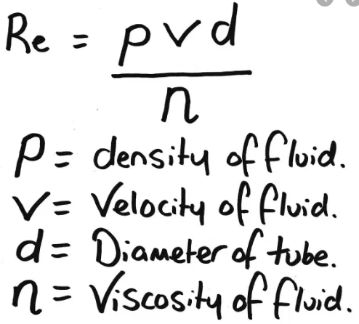
RCOA competence: PC_BK_77
6. Flow through a tube is more likely to be turbulent if:
F T F T T
< 2000 laminar
2000 – 4000 transitional
>4000 Turbulent flow
Heliox is breathed rather than air
Reynold’s number is greater than 4000
The viscosity of the fluid increases
The density of the fluid increases
The velocity of the fluid increases
Notes:
Answer slide

Slide 48
Concerning the Chi Squared Test
RCOA competence: PR_BK_20
The samples must be drawn at random from the population
It includes a calculation of expected frequencies
Measured variables must be independent
Cannot be used if there is an expected value of less than 5
Yates’ correction factor is applied for continuity
End
1
2
3
4
5
6
7
8
9
10
11
12
13
14
15
16
17
18
19
20
21
22
23
24
25
26
27
28
29
30
31
32
33
34
35
36
37
38
39
40
41
42
43
44
45
46
47
48
49
50
51
52
53
54
55
56
57
58
59
Notes:
Question slide with 1 minute timer

Slide 49
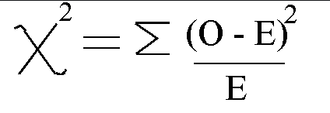
RCOA competence: PC_BK_77
7. Concerning Chi-Squared Test:
T T T T T
Chi- Squared test:
Chi squared test compares the observed frequencies for an event with the expected frequency if the null hypothesis were true.
The sampling must be random
If less the expected value is less than 5, then Fischers Exact Test should be used
The samples must be drawn at random from the population
It includes a calculation of expected frequencies
Measured variables must be independent
Cannot be used if there is an expected value of less than 5
Yates’ correction factor is applied for continuity
Notes:
Answer slide

Slide 50
The standard deviation of a normally distributed population:
RCOA competence: PR_BK_20
Is a small distribution curve with a tall peak
Is the square root of the variance
Is greater than the standard error of the mean
Defines the range of the population
May require logarithmic transformation to apply parametric tests
End
1
2
3
4
5
6
7
8
9
10
11
12
13
14
15
16
17
18
19
20
21
22
23
24
25
26
27
28
29
30
31
32
33
34
35
36
37
38
39
40
41
42
43
44
45
46
47
48
49
50
51
52
53
54
55
56
57
58
59
Notes:
Question slide with 1 minute timer

Slide 51
RCOA competence: PC_BK_77
8. The standard deviation of a normally distributed population:
T T T F F
Standard deviation is the expression of variability in a population
SD = square root of the variance
Can use parametric tests for normally distributed data
If data is NOT normally distributed, therefore skewed… logarithmic transformation can be applied -> then parametric tests can be used
Is a small distribution curve with a tall peak
Is the square root of the variance
Is greater than the standard error of the mean
Defines the range of the population
May require logarithmic transformation to apply parametric tests
Notes:
Answer slide

Slide 52
Regarding Statistical Tests:
RCOA competence: PR_BK_20
The mean is the most frequently occuring observation in a series
The standard deviation gives an indication of the spread of the observations
The middle value in an ordered series is the median
95% of all values lie within 2 standard deviations
The standard deviation indicates the significance of the observations
End
1
2
3
4
5
6
7
8
9
10
11
12
13
14
15
16
17
18
19
20
21
22
23
24
25
26
27
28
29
30
31
32
33
34
35
36
37
38
39
40
41
42
43
44
45
46
47
48
49
50
51
52
53
54
55
56
57
58
59
Notes:
Question slide with 1 minute timer

Slide 53

RCOA competence: PC_BK_77
9. Regarding statistical tests:
F T T T F
Mean is the average of the population
MOde is the MOst frequently occuring
Median is the exact mid point of values when arranged in order
Standard deviation is the measure of spread of observations about the mean
The mean is the most frequently occuring observation in a series
The standard deviation gives an indication of the spread of the observations
The middle value in an ordered series is the median
95% of all values lie within 2 standard deviations
The standard deviation indicates the significance of the observations
Notes:
Answer slide

Slide 54
When the distribution is positively skewed:
RCOA competence: PR_BK_20
The tail on the left is longer than the tail on the right
The distribution could have more than one mode
Most observations are less than the mean
The standard deviation is less than the variance
The median is greater than the mean
End
1
2
3
4
5
6
7
8
9
10
11
12
13
14
15
16
17
18
19
20
21
22
23
24
25
26
27
28
29
30
31
32
33
34
35
36
37
38
39
40
41
42
43
44
45
46
47
48
49
50
51
52
53
54
55
56
57
58
59
Notes:
Question slide with 1 minute timer

Slide 55
RCOA competence: PC_BK_77
10. When distribution is positively skewed:
F F T T F
The tail on the left is longer than the tail on the right
The distribution could have more than one mode
Most observations are less than the mean
The standard deviation is less than the variance
The median is greater than the mean
Notes:
Answer slide

Slide 56
The following are non-parametric tests:
RCOA competence: PR_BK_20
Mann-Whitney U Test
ANOVA
Unpaired Students T Test
Wilcoxon signed rank test
Kruskal-Wallis
End
1
2
3
4
5
6
7
8
9
10
11
12
13
14
15
16
17
18
19
20
21
22
23
24
25
26
27
28
29
30
31
32
33
34
35
36
37
38
39
40
41
42
43
44
45
46
47
48
49
50
51
52
53
54
55
56
57
58
59
Notes:
Question slide with 1 minute timer

Slide 57
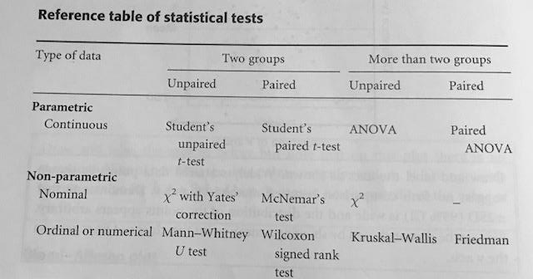
RCOA competence: PC_BK_77
11: The following are non-parametric tests:
T F F T T
Mann-Whitney U Test
ANOVA
Unpaired Students T Test
Wilcoxon signed rank test
Kruskal-Wallis
Notes:
Answer slide

Slide 58
Regarding a thermistor:
RCOA competence: PR_BK_20
It uses a platinum wire resistor
Has a rapid response time
Can be made very small
Resistance falls exponentially with temperature
Accuracy is improved by the incorporation of a wheatstone bridge
End
1
2
3
4
5
6
7
8
9
10
11
12
13
14
15
16
17
18
19
20
21
22
23
24
25
26
27
28
29
30
31
32
33
34
35
36
37
38
39
40
41
42
43
44
45
46
47
48
49
50
51
52
53
54
55
56
57
58
59
Notes:
Question slide with 1 minute timer

Slide 59
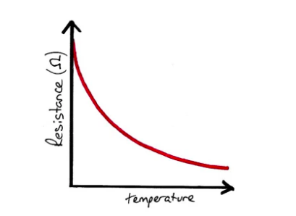
RCOA competence: PC_BK_77
12. Regarding a thermistor:
F T T T T
Made from a metal oxide bead
Advantages:
-Rapid response time
-Can be small
-Durable
Accuracy can be improved with incorporation in a wheatstone bridge.
It uses a platinum wire resistor
Has a rapid response time
Can be made very small
Resistance falls exponentially with temperature
Accuracy is improved by the incorporation of a wheatstone bridge
Notes:
Answer slide

Slide 60
Regarding humidity:
RCOA competence: PR_BK_20
Absolute humidity is the volume of water vapour in a volume of gas
Absolute humidity of fully saturated air at 37 degrees contains 44mg/l water
Absolute humidity is dependent on ambient temperature
Humidified gas reduces heat loss by sparing latent heat of vapourisation
As temperature increases in a closed system, the relative humidity increases
End
1
2
3
4
5
6
7
8
9
10
11
12
13
14
15
16
17
18
19
20
21
22
23
24
25
26
27
28
29
30
31
32
33
34
35
36
37
38
39
40
41
42
43
44
45
46
47
48
49
50
51
52
53
54
55
56
57
58
59
Notes:
Question slide with 1 minute timer

Slide 61
RCOA competence: PC_BK_77
13. Regarding humidity:
F T T T F
Absolute humidity is the MASS of water vapour in a volume of gas ( g m⁻³ )
Relative humidity is the ratio of water vapour present against the maximum possible ie SVP
RH = (actual vapour pressure) / (SVP)
As temperature increases the relative humidity decreases:
Eg Fully saturated air at 20 degrees has 17 g m⁻³
17/17 x 100 = 100%
If this air is heated to 37 degrees….
Same mass of water but relative humidity decreases
17/44 x 100 = 39%
Absolute humidity is the volume of water vapour in a volume of gas
Absolute humidity of fully saturated air at 37 degrees contains 44 g m⁻³ water
Absolute humidity is dependent on ambient temperature
Humidified gas reduces heat loss by sparing latent heat of vapourisation
As temperature increases in a closed system, the relative humidity increases
Notes:
Answer slide

Slide 62
Oesophageal Doppler cardiac output measurement:
RCOA competence ref e.g. PC_BK_77
Depends on blood flow in the ascending aorta
Is not influenced by body temperature
Can be tolerated by awake patients
Can be used in children
The probe is usually inserted to 60cm
End
1
2
3
4
5
6
7
8
9
10
11
12
13
14
15
16
17
18
19
20
21
22
23
24
25
26
27
28
29
30
31
32
33
34
35
36
37
38
39
40
41
42
43
44
45
46
47
48
49
50
51
52
53
54
55
56
57
58
59
Notes:
Question slide with 1 minute timer

Slide 63
RCOA competence: PC_BK_77
14. Oesophageal Doppler cardiac output measurement::
F T F T F
Depends on blood flow in the DESCENDING aorta
Body temperature only affects CO measurement with PA catheters
Probe is usually inserted to 35-40cm from the incisors
Velocity of red blood cells is measured in the descending aorta using the Doppler effect.
Estimation of the length of a column of blood passing through the aorta per unit time.
Multiplied by the cross sectional area of the aorta to give CO
Flow = velocity x area
Depends on blood flow in the ascending aorta
Is not influenced by body temperature
Can be tolerated by awake patients
Can be used in children
The probe is usually inserted to 60cm
Notes:
Answer slide

Slide 64
A thermistor:
RCOA competence: PR_BK_20
Demonstrates the Seebeck effect
Shows a linear relationship between resistance and temperature
Has a resistance that changes with time
Exhibits hysteresis
May have a positive or negative temperature coefﬁcient
End
1
2
3
4
5
6
7
8
9
10
11
12
13
14
15
16
17
18
19
20
21
22
23
24
25
26
27
28
29
30
31
32
33
34
35
36
37
38
39
40
41
42
43
44
45
46
47
48
49
50
51
52
53
54
55
56
57
58
59
Notes:
Question slide with 1 minute timer

Slide 65
RCOA competence: PC_BK_77
15. A thermistor:
F T F T F
The Seebeck effect is the principle behind the thermocouple, where two dissimilar metals produce a voltage where they are joined.
The thermistor resistance increases exponentially as temperature falls, not in a linear fashion.
Calibration changes with severe changes in temperature.
Demonstrates the Seebeck effect
Shows a linear relationship between resistance and temperature
Has a resistance that changes with time
Exhibits hysteresis
May have a positive or negative temperature coefﬁcient
Notes:
Answer slide

Slide 66
Regarding heat loss in theatre:
RCOA competence: PR_BK_20
Convection is the predominant mechanism of heat loss
Conduction accounts for 20%
Respiration accounts for 2%
Radiation accounts for 10%
Evaporation is the least significant mechanism for heat loss
End
1
2
3
4
5
6
7
8
9
10
11
12
13
14
15
16
17
18
19
20
21
22
23
24
25
26
27
28
29
30
31
32
33
34
35
36
37
38
39
40
41
42
43
44
45
46
47
48
49
50
51
52
53
54
55
56
57
58
59
Notes:
Question slide with 1 minute timer

Slide 67
RCOA competence: PC_BK_77
16. Regarding heat loss in theatre:
F F F F F
Radiation: approx 40%
proportional to the environment/core temperature difference (to the power of four).
Convection up to 30%
due to loss of heat to air immediately surrounding the body. It is proportional to the velocity of the air.
Evaporation approx 15%
occurs from cleaning fluids, skin, respiratory, bowel and wound surfaces.
Respiratory approx 10%
enhanced by cooling effect of cold anaesthetic gases.
Conduction: up to 5%
due to heating surfaces in contact with the body such as theatre table or cold fluids.
Convection is the predominant mechanism of heat loss
Conduction accounts for 20%
Respiration accounts for 2%
Radiation accounts for 10%
Evaporation is the least significant mechanism for heat loss
Notes:
Answer slide

Slide 68
The following reduce intra-operative heat loss:
RCOA competence: PR_BK_20
Addition of the HME filter in the breathing circuit
Using low flow anaesthesia
Laminar flow in orthopaedic theatres
Using a bowel bag in a laparotomy
Maintain pre-operative patient temperature between 35-36 degrees
End
1
2
3
4
5
6
7
8
9
10
11
12
13
14
15
16
17
18
19
20
21
22
23
24
25
26
27
28
29
30
31
32
33
34
35
36
37
38
39
40
41
42
43
44
45
46
47
48
49
50
51
52
53
54
55
56
57
58
59
Notes:
Question slide with 1 minute timer

Slide 69
RCOA competence: PC_BK_77
17. The following reduce intra-operative heat loss:
T T F T F
Radiation: approx 40%
proportional to the environment/core temperature difference (to the power of four).
Convection up to 30%
due to loss of heat to air immediately surrounding the body. It is proportional to the velocity of the air.
Evaporation approx 15%
occurs from cleaning fluids, skin, respiratory, bowel and wound surfaces.
Respiratory approx 10%
enhanced by cooling effect of cold anaesthetic gases.
Conduction: up to 5%
due to heating surfaces in contact with the body such as theatre table or cold fluids.
Patients pre-operative <36 degrees are at higher risk intraoperative hypothermia
Addition of the HME filter in the breathing circuit
Using low flow anaesthesia
Laminar flow in orthopaedic theatres
Using a bowel bag in a laparotomy
Maintain pre-operative patient temperature between 35-36 degrees
Notes:
Answer slide

Slide 70
Regarding heat:
RCOA competence: PR_BK_20
Specific heat capacity is the heat energy required to raise the temperature of a unit mass of a substance by 1K
The triple point of water occurs at 611 pa and 1°C
The copper heat sink in a vapourizer has a low specific heat capacity
The specific heat capacity of gases is less than liquids
The unit of specific heat capacity is joules/K
End
1
2
3
4
5
6
7
8
9
10
11
12
13
14
15
16
17
18
19
20
21
22
23
24
25
26
27
28
29
30
31
32
33
34
35
36
37
38
39
40
41
42
43
44
45
46
47
48
49
50
51
52
53
54
55
56
57
58
59
Notes:
Question slide with 1 minute timer

Slide 71
RCOA competence: PC_BK_77
18. Regarding heat:
T T F T F
The triple point of water - at 611 Pa and 0.01°C – all 3 phases (solid, liquid and gas) are in equilibrium
Gases have very low heat capacity
Metals, in particular copper, have a high specific heat capacity
Specific heat capacity is the heat energy required to raise the temperature of a unit mass of a substance by 1K
Units joules/ kg per K
Specific heat capacity is the heat energy required to raise the temperature of a unit mass of a substance by 1K
The triple point of water occurs at 611 pa and 1°C
The copper heat sink in a vapourizer has a low specific heat capacity
The specific heat capacity of gases is less than liquids
The unit of specific heat capacity is joules/K
Notes:
Answer slide

Slide 72
Regarding the scavenging and the maximum levels of anaesthetic gases:
RCOA competence: PR_BK_20
Concentrations are measured over a 12 hour period
Is measured in PPM, which is, parts per cubic metre
Maximum for N₂0 is 100 PPM
Maximum for Halothane is 50 PPM
Maximum for Isoflurane is 50 PPM
End
1
2
3
4
5
6
7
8
9
10
11
12
13
14
15
16
17
18
19
20
21
22
23
24
25
26
27
28
29
30
31
32
33
34
35
36
37
38
39
40
41
42
43
44
45
46
47
48
49
50
51
52
53
54
55
56
57
58
59
Notes:
Question slide with 1 minute timer

Slide 73
RCOA competence: PC_BK_77
19. Regarding the scavenging and the maximum levels of anaesthetic gases: :
F F T F T
Maximum levels in the UK :
Measure over 8 hour period
PPM = parts per million
N₂O 100 PPM
Isoflurane 50 PPM
Enflurane 50 PPM
Halothane 10 PPM
Concentrations are measured over a 12 hour period
Is measured in PPM, which is, parts per cubic metre
Maximum for N₂0 is 100 PPM
Maximum for Halothane is 50 PPM
Maximum for Isoflurane is 50 PPM
Notes:
Answer slide

Slide 74
The following can be compressed into a gas at room temperature:
RCOA competence: PR_BK_20
Nitrous oxide
Carbon dioxide
Entonox
Air
Xenon
End
1
2
3
4
5
6
7
8
9
10
11
12
13
14
15
16
17
18
19
20
21
22
23
24
25
26
27
28
29
30
31
32
33
34
35
36
37
38
39
40
41
42
43
44
45
46
47
48
49
50
51
52
53
54
55
56
57
58
59
Notes:
Question slide with 1 minute timer

Slide 75
RCOA competence: PC_BK_77
20. The following can be compressed into a gas at room temperature: :
T T F F F
Gas is above its critical temperature.
=> Gas cannot be compressed into a liquid above its critical temp, regardless of the pressure applied
Vapour is below its critical temperature
Nitrous oxide critical temp is 36.5 degrees
Carbon dioxide critical temp is 31 degrees
Nitrous oxide
Carbon dioxide
Entonox
Air
Xenon
Notes:
Answer slide

Slide 76
The following are the correct pin index configurations :
RCOA competence: PR_BK_20
Oxygen 2 and 6
Nitrous oxide 3 and 5
Entonox 3 and 6
Carbon dioxide 1 and 6
Helium 2 and 5
End
1
2
3
4
5
6
7
8
9
10
11
12
13
14
15
16
17
18
19
20
21
22
23
24
25
26
27
28
29
30
31
32
33
34
35
36
37
38
39
40
41
42
43
44
45
46
47
48
49
50
51
52
53
54
55
56
57
58
59
Notes:
Question slide with 1 minute timer

Slide 77
RCOA competence: PC_BK_77
21. The following are the correct pin index configurations:
F T F T F
Air 1 and 5
Oxygen 2 and 5
N₂O 3 and 5
CO₂ 1 and 6
Entonox 3
Helium 2 and 4
Oxygen 2 and 6
Nitrous oxide 3 and 5
Entonox 3 and 6
Carbon dioxide 1 and 6
Helium 2 and 5
Notes:
Answer slide

Slide 78
Oxygen for medical use:
RCOA competence: PR_BK_20
Is prepared by the fractional distillation of air
For pipelines contains 0.3% nitrogen
Forms an inflammable mixture with oil
From concentrators forms an FiO2 of over 80%
Has similar magnetic properties as nitrous oxide
End
1
2
3
4
5
6
7
8
9
10
11
12
13
14
15
16
17
18
19
20
21
22
23
24
25
26
27
28
29
30
31
32
33
34
35
36
37
38
39
40
41
42
43
44
45
46
47
48
49
50
51
52
53
54
55
56
57
58
59
Notes:
Question slide with 1 minute timer

Slide 79
RCOA competence: PC_BK_77
23. Oxygen for medical use:
F T F T F
Oxygen is manufactured by the fractional distillation of air.
Air is compressed to 5 atmospheres and cooled to -200ºC using reverse heat exchangers.
A two-stage distillation process yields 99.5% O₂ (and 0.4% argon).
Oxygen = paramagnetic
=> which means that it is weakly attracted into a magnetic field.
This is because it has two electrons in unpaired orbits.
Nitric oxide (NO) = paramagnetic
Most of the gases used in anaesthesia are repelled by a magnetic field (diamagnetism).
e.g. N₂O
Is prepared by the fractional distillation of air
For pipelines contains 0.3% nitrogen
Forms an inflammable mixture with oil
From concentrators forms an FiO2 of over 80%
Has similar magnetic properties as nitrous oxide
Notes:
Answer slide

Slide 80
The following are found on anaesthetic gas cylinders:
RCOA competence: PR_BK_20
The weight of the empty cylinder
Weight of the cylinder when full
Chemical formula of the contents
Date of manufacture
Test pressure
End
1
2
3
4
5
6
7
8
9
10
11
12
13
14
15
16
17
18
19
20
21
22
23
24
25
26
27
28
29
30
31
32
33
34
35
36
37
38
39
40
41
42
43
44
45
46
47
48
49
50
51
52
53
54
55
56
57
58
59
Notes:
Question slide with 1 minute timer

Slide 81
RCOA competence: PC_BK_77
24. The following are found on anaesthetic gas cylinders:
T F T T T
Gas cylinders are tested every 5 years
The body and collar of the cylinder are colour coded for the gas they contain.
On the neck and valve block are etched a serial number and chemical symbol of the gas or liquid, the pressure to which the cylinder has been tested, the company supplying the cylinder and the empty or tare weight.
A pin index system is on the side facing the yoke.
Details of the last test are indicated by a plastic ring that is put round the base of the valve. Colour coded for year.
The weight of the empty cylinder
Weight of the cylinder when full
Chemical formula of the contents
Date of last test performed
Test pressure
Notes:
Answer slide

Slide 82
Regarding cylinders:
RCOA competence: PR_BK_20
They are made of titanium
The colour of the plastic disc around their neck denotes the year of manufacture
They are tested every 3 years
they are designed to operate to a 60%–70% higher pressure than the usual ﬁlling pressure
The filling ratio is higher in tropical climates
End
1
2
3
4
5
6
7
8
9
10
11
12
13
14
15
16
17
18
19
20
21
22
23
24
25
26
27
28
29
30
31
32
33
34
35
36
37
38
39
40
41
42
43
44
45
46
47
48
49
50
51
52
53
54
55
56
57
58
59
Notes:
Question slide with 1 minute timer

Slide 83
RCOA competence: PC_BK_77
25. Regarding cylinders:
F F F T F
Cylinders are molybdenum steel or chromium steel, which are high-strength alloys. Aluminium cylinders are an alternative lighter weight.
Gas cylinders are tested every 5 years
The body and collar of the cylinder are colour coded for the gas they contain.
Details of the last test are indicated by a plastic ring that is put round the base of the valve. Colour coded for year.
They are made of a titanium alloy
The colour of the plastic disc around their neck denotes the year of manufacture
They are tested every 3 years
they are designed to operate to a 60%–70% higher pressure than the usual ﬁlling pressure
The filling ratio is higher in tropical climates
Notes:
Answer slide

